Slide 1

CROP RECOMMENDATION USING MACHINE LEARNING
Likhith
Shalu
Tarun

Slide 2
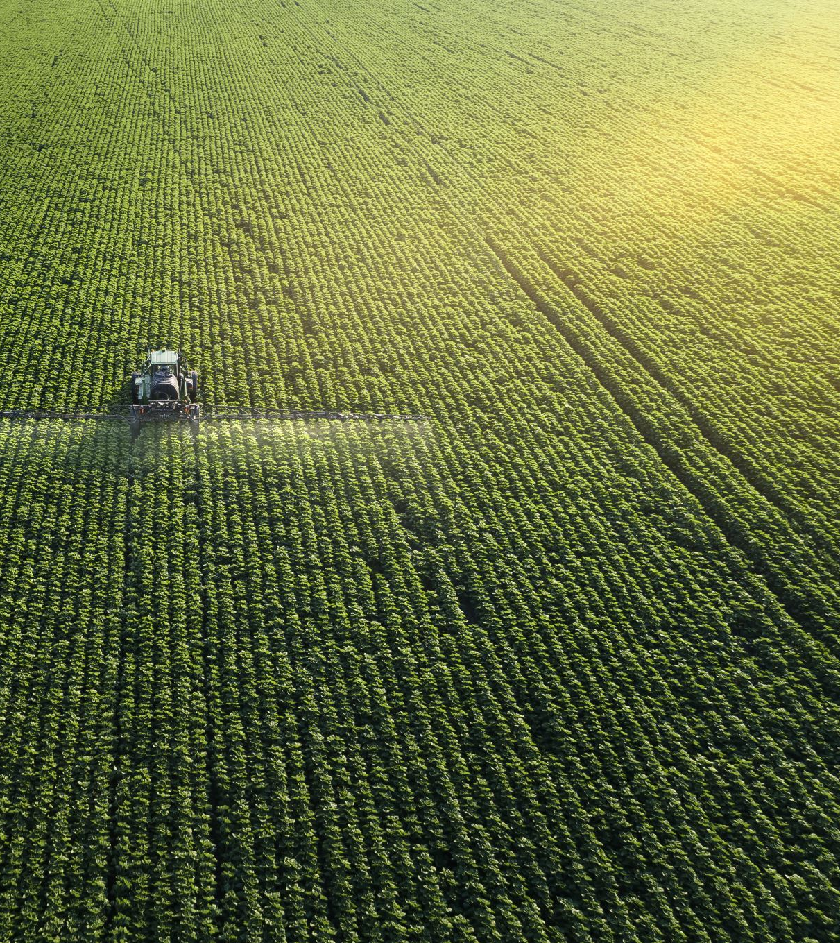
Business needs:
1. Increased crop yields: Machine learning helps farmers to optimize their irrigation schedules, fertilizer application rates, and pesticide use to reduce wastage and environmental harm. This can lead to increased crop yields, which can improve food security and reduce hunger.
2. Cost savings: Machine learning can help farmers save money on crucial resources like water, fertilizer, and pesticides. This can increase the profits and make farming more sustainable in the long term.

Slide 3
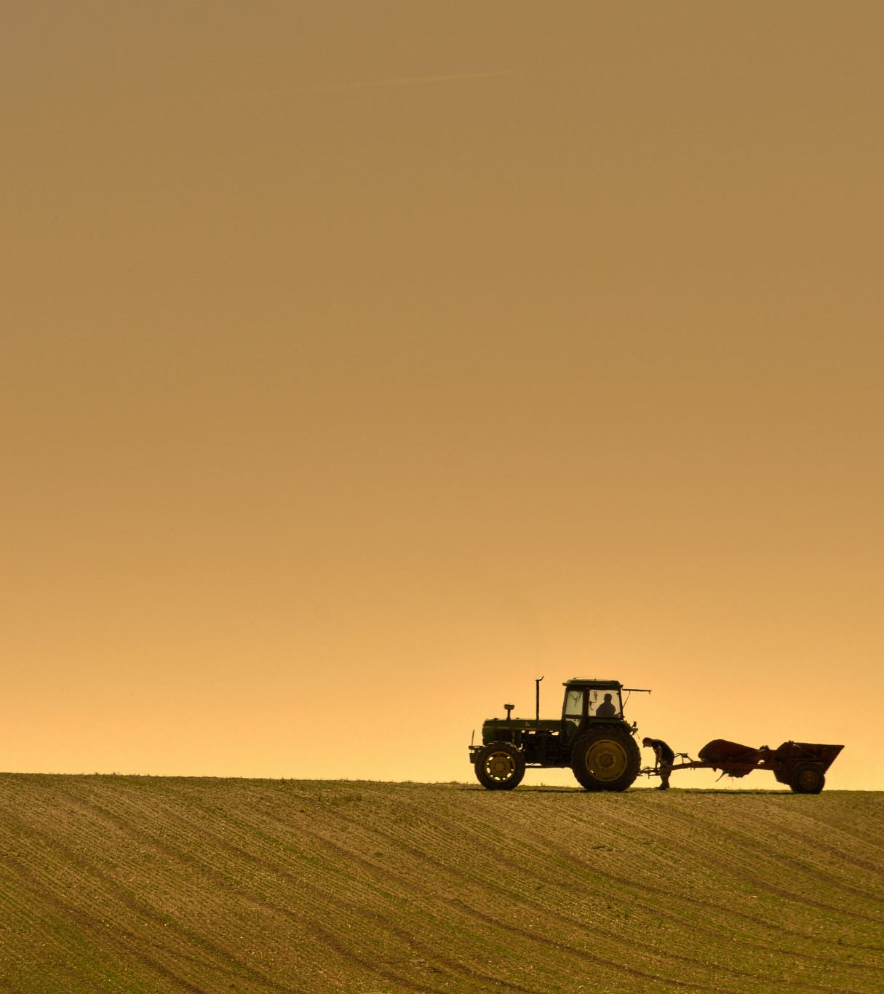
3. Personalized recommendations: Machine learning provides farmers with personalized recommendations for planting, irrigation, and fertilization. This can help farmers make better decisions about when to plant, how to irrigate, and when to apply fertilizers.
4. Improved safety: Machine learning can help farmers avoid hazardous tasks such as working with pesticides. This can improve farm workers’ safety and health.

Slide 4

5. Adaptation to changing conditions: Machine learning can help farmers adapt their practices to cope with changing weather patterns, which can strengthen adaptability to changing climate conditions.
It can also help farmers manage their land in a way that conserves biodiversity, which can safeguard ecosystem services and preserve natural resources.
6. Early warning systems: Machine learning can be used in early warning systems that alert farmers about potential pest outbreaks, soil degradation, water scarcity, and climate change. It can also be used to develop models for predicting the spread of pests and diseases.

Slide 5
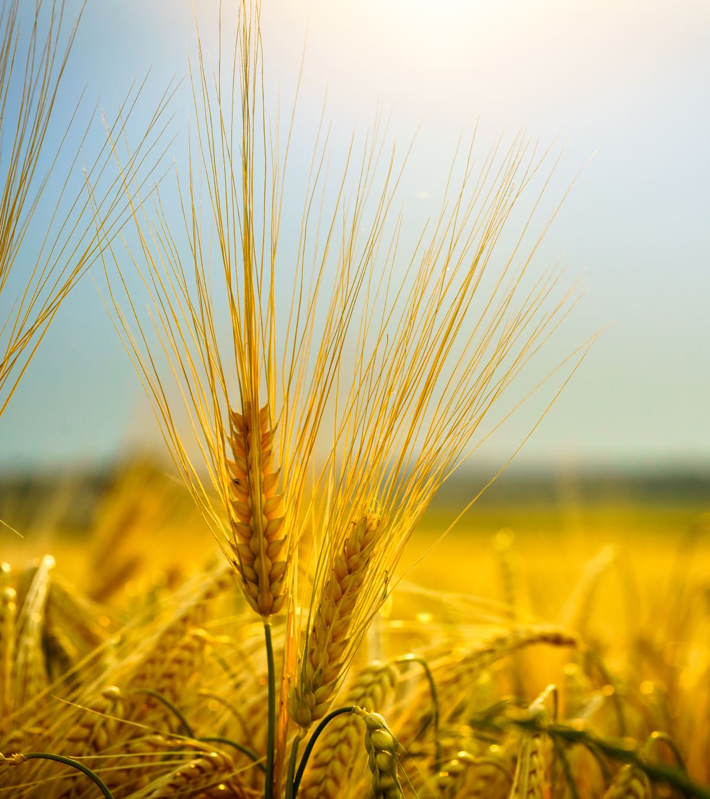
PROBLEM STATEMENT:
Problem: Farmers usually find it hard to tell which crops to cultivate and generally use factors like soil type and climate conditions to arrive at a decision. This will most certainly result in lower crop yields, as well as the negative impact on the environment and farmer’s income.
Objective: The purpose of our project is to create a crop advice system with artificial intelligence for farmers so that they will be able to make the right choice between agriculture services.

Slide 6
DATA SOURCE:
https://ieee-dataport.org/documents/crop-recommendation#files
https://docs.google.com/spreadsheets/d/1E-SFSIeQpcbu5X9zISHPj66mL6I7kg1y/edit#gid=878297588
https://dataverse.harvard.edu/file.xhtml?fileId=6881146&version=1.0

Slide 7
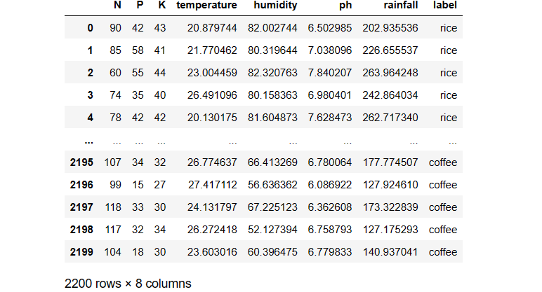
DATASET PREVIEW:

Slide 8
Implementation of models
K-Means clustering
Random Forest
PYOD LOF Algorithm for outlier detection
Decision Trees
Regression
Background Scaling
Min-Max Scaling
One hot encoder
Standard Scaler

Slide 9
K-Means Clustering
K-means is an unsupervised machine learning algorithm used for clustering similar data points into groups, or "clusters," based on their features. The goal of K-means is to partition a dataset into K clusters, where each data point belongs to the cluster with the nearest mean, or centroid. The algorithm iteratively assigns data points to the nearest centroid and updates the centroids until convergence, minimizing the within-cluster variance
K-means clustering can be used in crop recommendation systems to group regions or fields with similar characteristics, such as soil type, climate, elevation, and historical crop yields.

Slide 10
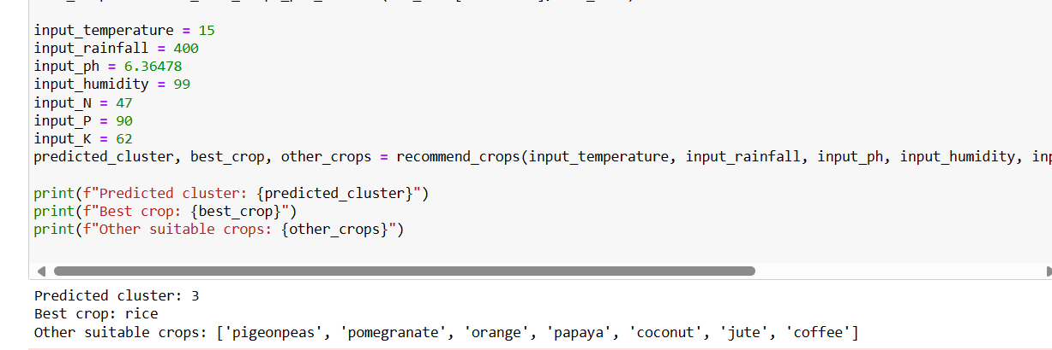
Model

Slide 11
Random Forest
Random Forest is a supervised machine learning algorithm that operates by constructing a multitude of decision trees during training and outputs the class that is the mode of the classes (classification) or mean prediction (regression) of the individual trees. It enhances accuracy and reduces overfitting by combining the predictions of multiple decision trees
Random Forest can be applied in crop recommendation systems to predict suitable crops for a given region based on various factors such as soil type, climate, temperature, rainfall, elevation, historical crop yields, etc.

Slide 12
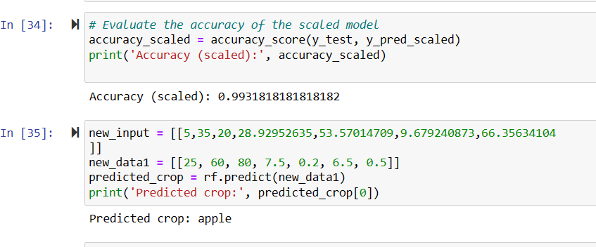
Model

Slide 13
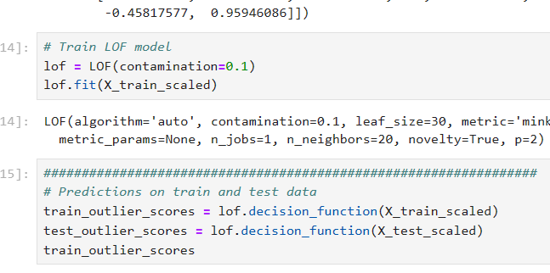
PYOD LOC Implementation

Slide 14
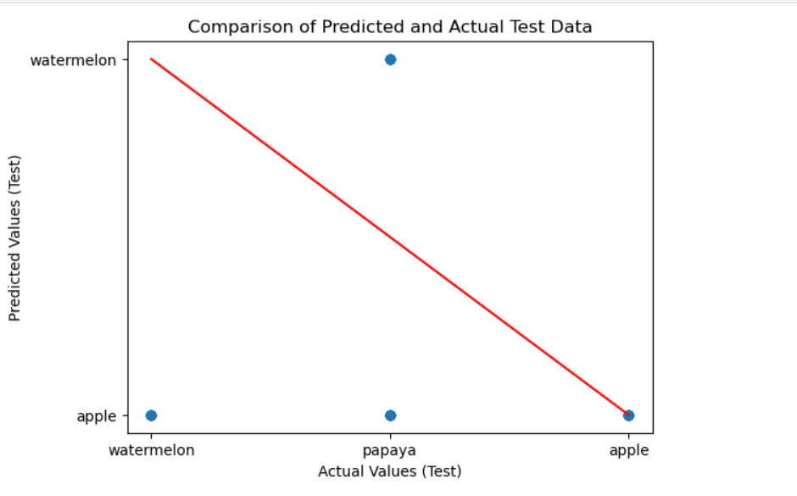
Plots from the algorithm

Slide 15
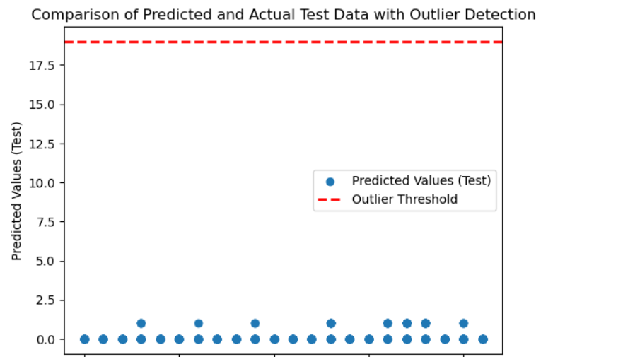
Predicted data deviation

Slide 16
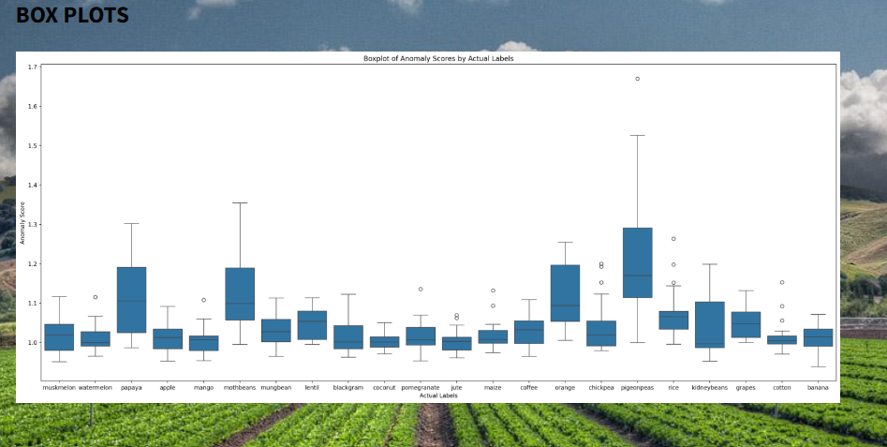
Box plots

Slide 17
Accuracy
Scores: Linear Regression
R-squared: 0.25634813007312407
Adjusted R-squared: 0.24429821551412378
Mean Squared Error (MSE): 31.474262588659084
Root Mean Squared Error (RMSE): 5.6101927407762995
Mean Absolute Error (MAE): 4.433454392161998
Scores: Decision trees
Accuracy: 0.9863636363636363
Precision: 0.9868055555555556
Recall: 0.9863636363636363
F1 Score: 0.9863152866630287

Slide 18
Scores: Random Forest
Accuracy: 0.9931818181818182
Precision: 0.9937348484848485
Recall: 0.9931818181818182
F1 Score: 0.9931754816901672

Slide 19
Stream lit
Streamlit is a free and open-source framework to rapidly build and share beautiful machine learning and data science web apps. It is a Python-based library specifically designed for machine learning engineers.
While not difficult, Streamlit does require some time to learn its own syntax.
Streamlit is not that flexible. It is only based on Python, offers a limited set of widgets, and doesn't integrate with Python Notebooks.
The data upload limit is only 50Mb.
There is limited support for video/animation.

Slide 20
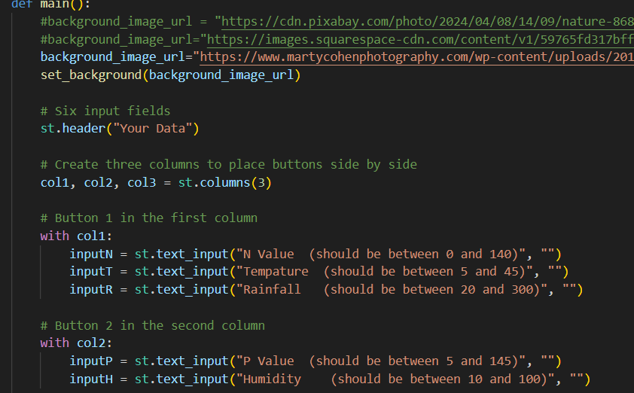

Slide 21
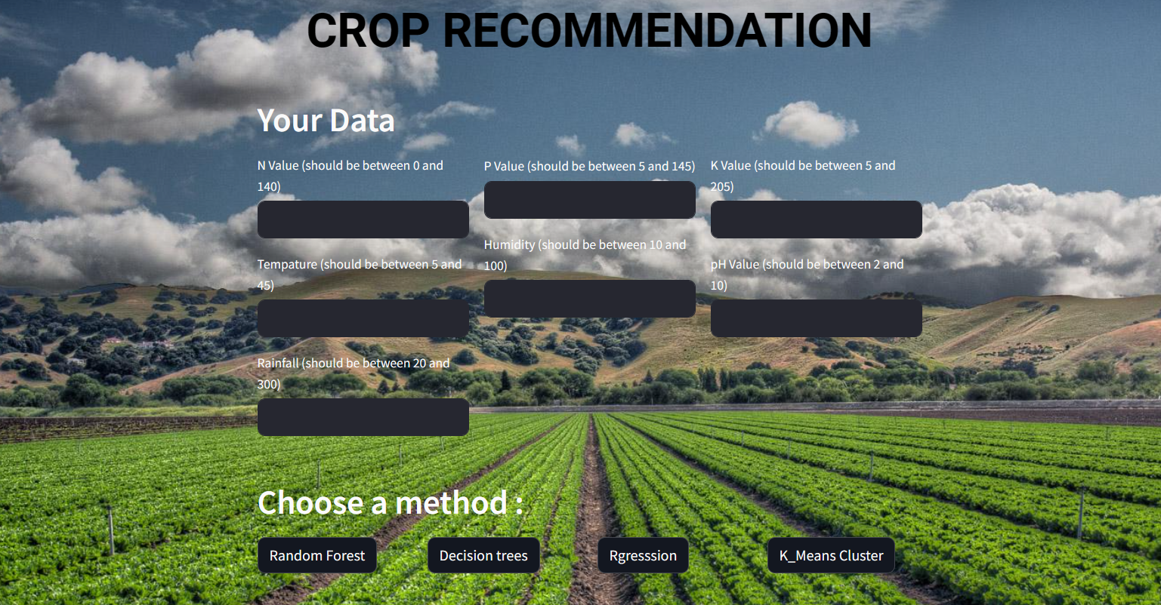
Front End

Slide 22
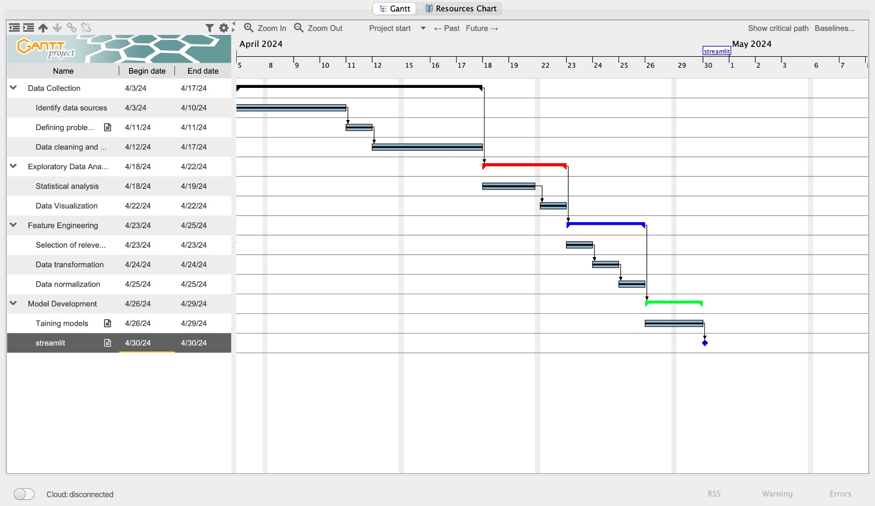

Slide 23
Summary
The project aims to develop a crop recommendation system using machine learning algorithms to assist farmers in selecting suitable crops for cultivation based on various environmental factors and agricultural parameters. By analyzing historical data on climate conditions, soil properties, crop yields, and other relevant variables, the system will generate personalized recommendations to maximize agricultural productivity and sustainability.

Slide 24
references
https://oppla.eu/casestudy/19448
https://www.ncbi.nlm.nih.gov/pmc/articles/PMC10520008/ --main.
https://www.mdpi.com/2673-4591/58/1/97
https://iopscience.iop.org/article/10.1088/1748-9326/9/6/064025/meta
https://zenodo.org/records/7059923
https://www.ncbi.nlm.nih.gov/pmc/articles/PMC8877115/#B17-micromachines-13-00250
https://ieeexplore.ieee.org/document/7891032
https://github.com/absmahi01/Krishi-ML-Based-Farming-Website/blob/main/Data%20raw/Fertilizer.csv
https://iopscience.iop.org/article/10.1088/1748-9326/9/6/064025/meta
https://www.thespruceeats.com/what-is-urban-farming-5188341https://oppla.eu/casestudy/19448
https://www.ncbi.nlm.nih.gov/pmc/articles/PMC10520008/ --main.
https://www.mdpi.com/2673-4591/58/1/97
https://iopscience.iop.org/article/10.1088/1748-9326/9/6/064025/meta
https://zenodo.org/records/7059923
https://www.ncbi.nlm.nih.gov/pmc/articles/PMC8877115/#B17-micromachines-13-00250
https://ieeexplore.ieee.org/document/7891032
https://github.com/absmahi01/Krishi-ML-Based-Farming-Website/blob/main/Data%20raw/Fertilizer.csv
https://iopscience.iop.org/article/10.1088/1748-9326/9/6/064025/meta
https://www.thespruceeats.com/what-is-urban-farming-5188341

Slide 25
Thank You

